Slide 1

Exercise 3 Activity

Slide 2
Exercise 3
How are weight-at-age and maturity-at-age changing over time?
What parameter(s) would you use to represent how productivity is changing over time?
How would you describe the change in productivity over time?

Slide 3
Exercise 3
Q1
Approaches:
Pros
Cons
Q2
Preferred approach:
Best practice criteria?
Assumptions?

Slide 4
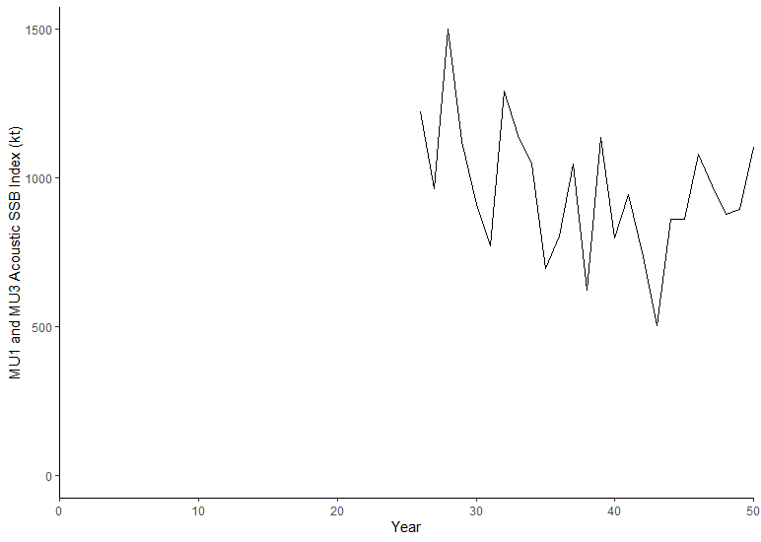
Exercise 3
Q3
Add plot here from R
Q4
Stock status in Year 20?
Stock status in Year 50?

Slide 5
Exercise 3 Presentation Slide (to share at the workshop tomorrow)

Slide 6
Break Out Group Add Number
Indicator:
LRP:
Rationale:
Stock status year 20:
Stock status year 50:
Add plot here
Submit all slides to Tim.Barrett@dfo-mpo.gc.ca when complete

